Slide 1
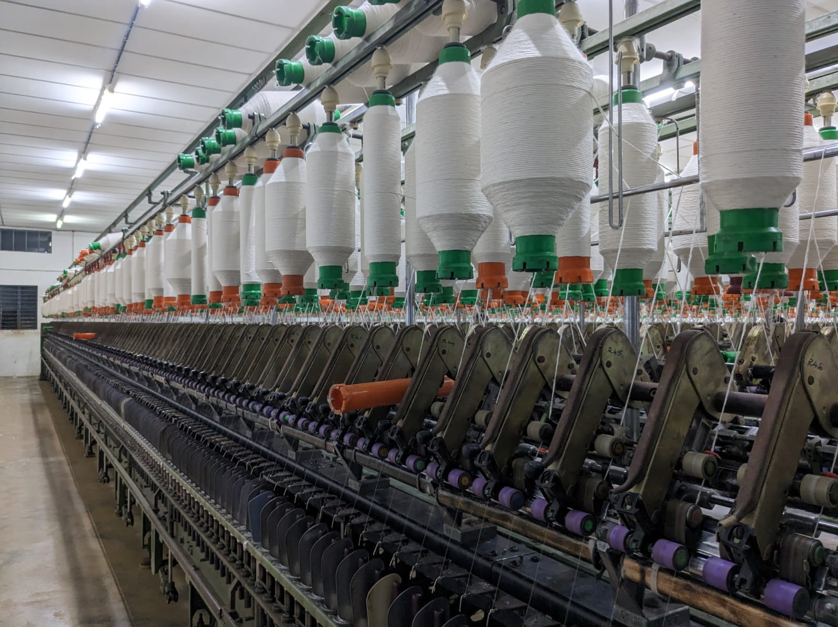
IOT PROJECT ON TEXTILE INDUSTRY
Smart monitoring system

Slide 2
INTRODUCTION
The proposed IOT project is designed to analyze and alert the textile machine's on/off status. The thread on the textile machine will break frequently, that causes the machine to stand idle. In that case, workers will leave the machine idle for longer than 15 minutes, which reduce the production and increase electricity usage. The proposed sensor measure the buzzer light which is installed on machine to read intensity and record the machine's reading and alert the workers about the machine's status. Then the data is transmitted to web application or an mobile app application. The IOT is used to assemble, collect, format the data and this will allow us to evaluate employee performance and boost production in the industries.

Slide 3
PROBLEMS FACED:
There are many machines involved in the process of converting big cotton bundles and threads, to smaller threads which includes machine such as Guarding, Simplex, and RSP. These machines frequently experience cutting of thread, which stops the machine's production. When workers fail to notice the machine's cutoff, the machine may remain idle for ten to fifteen minutes, which ultimately leads to decrease in production and increase in electricity use.

Slide 4
SOLUTION FORMULATED:
The main initiative is set up to address the issue in a way that the sensors(BH 1750) could anticipate the brightness of the buzzer, which is installed in each machine and glows when it is off. It would be simple to analyze worker's performance and output by measuring the light intensity and calculating the overall amount of time the machine has been idle. At the same time the sensors could send alert signals to the workers about machine idle time. The proposed results is to increase in production and decrease in electricity use. The data is extracted to the mobile application or the developed web page

Slide 5
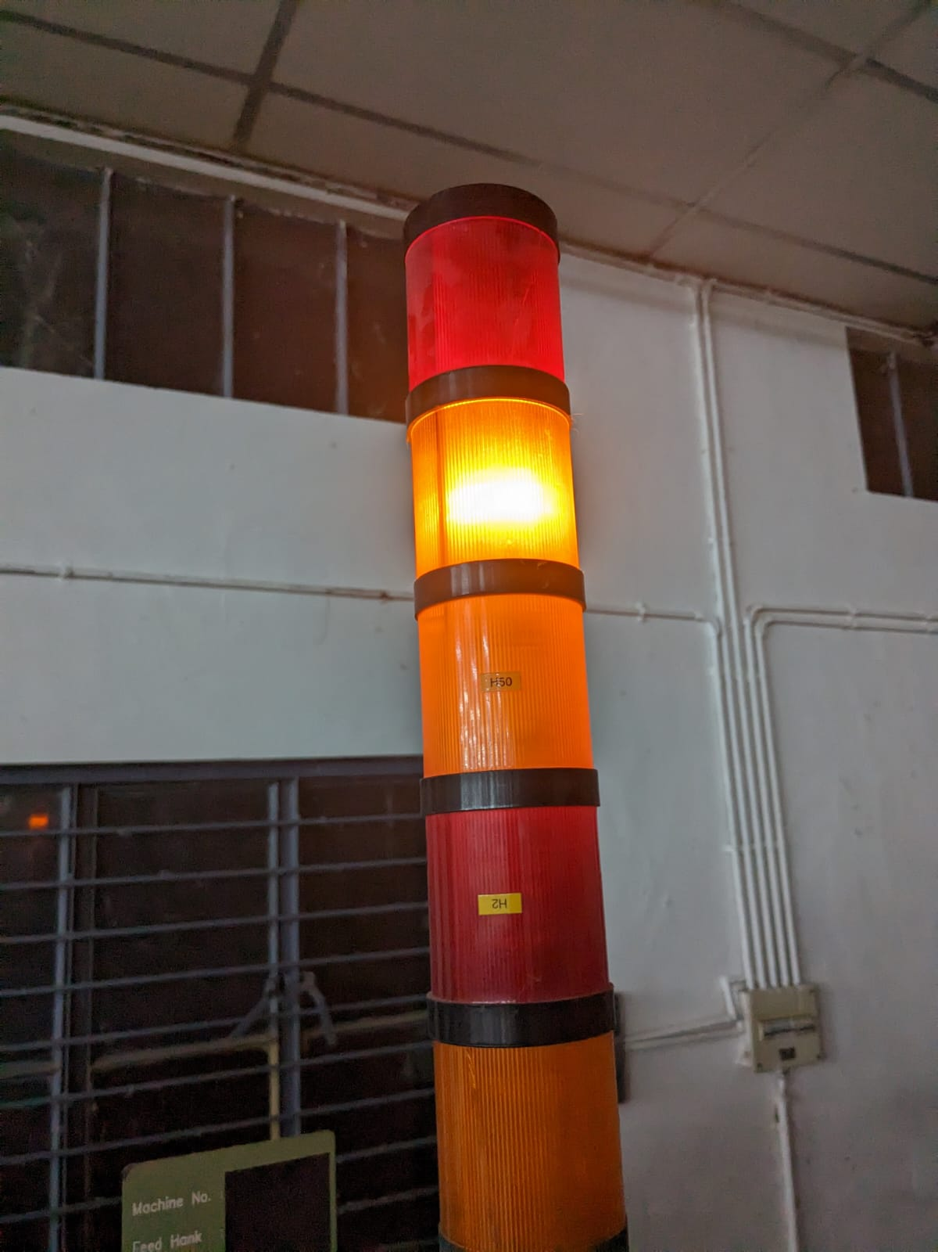
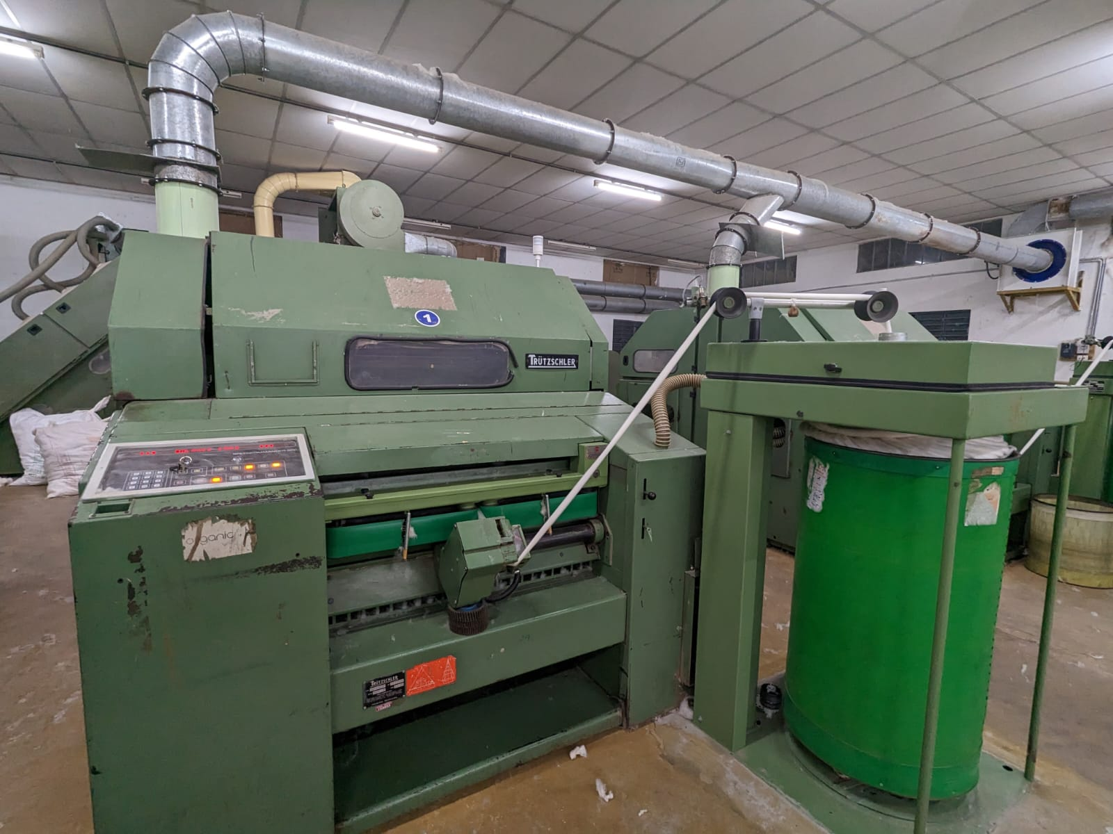

Slide 6
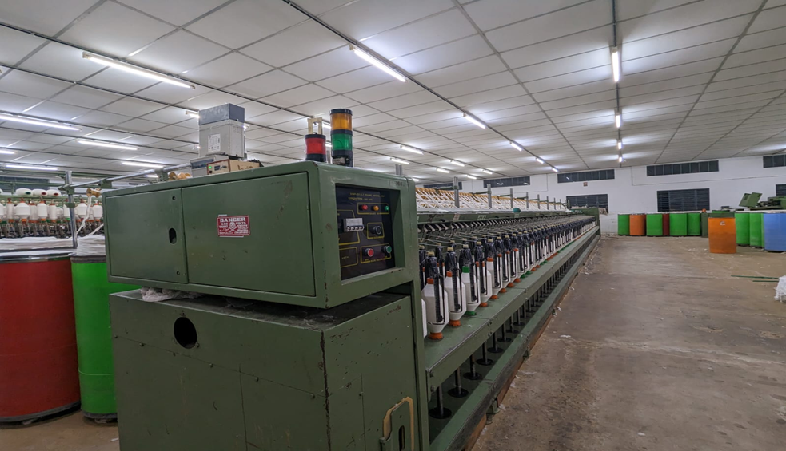

Slide 7
COMPONENTS USED IN THE PROJECT
LED DISPLAY -used to display the fluctuations in readings
BREAD BOARD-acts as an intermediate in the building of circuit
ARDUINO UNO BOARD- Used for storing the code in the board
ESP32-acts as a WIFI or Bluetooth source for the circuit
BH1750- It is a light intensity sensor which records the lighting of the surroundings .
Jumper Wires for connecting are used as well

Slide 8
